Slide 1

Authentication Using Zero Knowledge Proof
Project Presentation
BY
MITU22BTCS0293 | GAURANG SHARMA
MITU22BTCS1037 | YOGESH THAKUR
MITU22BTCS0381 | KAUSHAL CHORDIYA
MITU22BTCS056 | PRADNYA KHORE
Guided By
Prof. Smita Gumaste
Department of Computer Science & Engineering, MITSoC, Loni Kalbhor

Slide 2
Index
1 INTRODUCTION
2 PROBLEM STATEMENT
3 LITERATURE SURVEY
4 OBJECTIVES
5 CONCEPT AND METHOD
6 IMPLEMENTATION
Department of Computer Science & Engineering, MITSoE, Loni Kalbhor

Slide 3
1. Introduction
Traditional authentication systems rely on users' passwords to verify identity. While widely used, this approach has significant security risks, including vulnerability to password theft, phishing attacks, and database breaches.
Zero Knowledge Proof (ZKP) authentication offers a more secure alternative by enabling users to prove their identity without revealing their password or any other sensitive information. In a ZKP system, the user demonstrates knowledge of a secret to the verifier without disclosing the secret itself. This method drastically reduces the risk of sensitive data exposure and enhances overall security.
Department of Computer Science & Engineering, MITSoE, Loni Kalbhor

Slide 4
Problem Statement
Traditional authentication methods, such as passwords and biometrics, expose sensitive information, making them vulnerable to attacks.
Zero-Knowledge Proof (ZKP) offers a secure alternative by allowing a user to prove knowledge of a secret without revealing the secret itself.
This project aims to develop an authentication system using ZKP, ensuring that no sensitive data is transmitted during the authentication process.
Domain – Cyber Security
Technology – Python
Department of Computer Science & Engineering, MITSoE, Loni Kalbhor

Slide 5
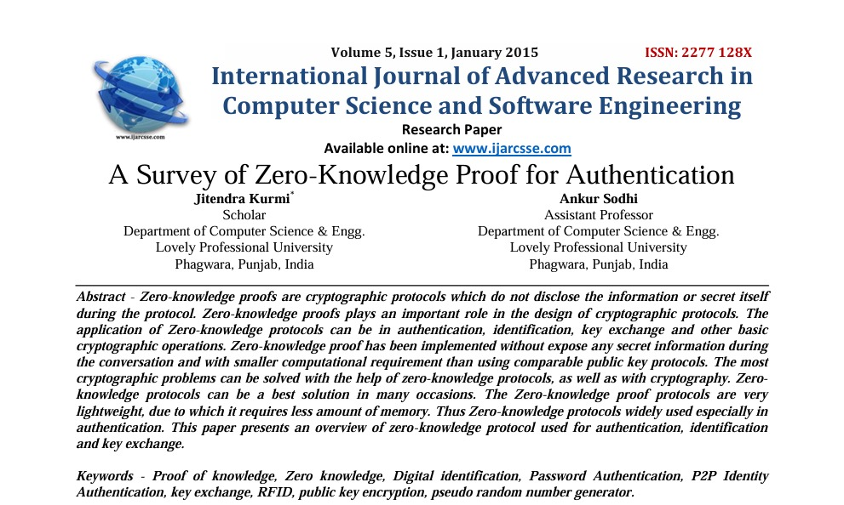
Literature Survey
The paper discusses various implementations of ZKPs that enhance security in cryptographic protocols, including methods to prevent common attacks like replay and man-in-the-middle attacks and passive attacks.
ZKPs are implemented to ensure security without revealing secrets, often requiring less computational power than public key protocols and promotes user privacy and also helps to prevent many cyber attacks.
Department of Computer Science & Engineering, MITSoE, Loni Kalbhor

Slide 6
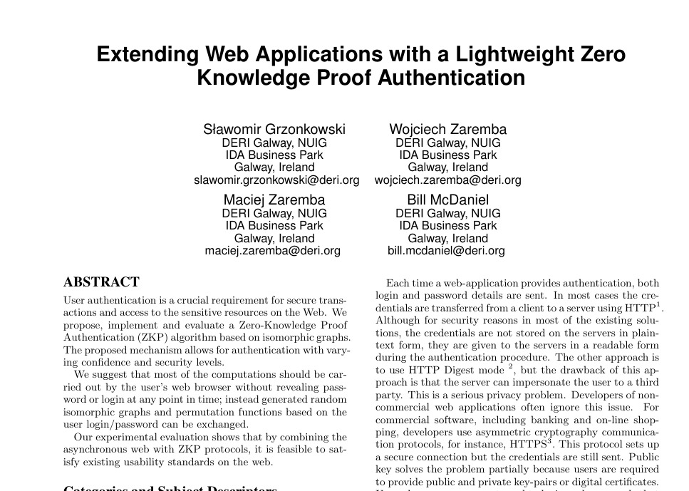
Literature Survey
One of the primary challenges identified in the paper is the variability in performance across different web browsers and hardware configurations.
For example, the authentication process takes longer on some browsers (like Opera) and may even fail if the process exceeds certain time thresholds.
Due to compatibility issues not every device is able to implement this authentication process
Department of Computer Science & Engineering, MITSoE, Loni Kalbhor

Slide 7

Objectives
1
To provide the user a more secure way of authentication
2
To deal with the privacy concerns of the user
3
To make this method compatible with all kinds of devices
Department of Computer Science & Engineering, MITSoE, Loni Kalbhor

Slide 8
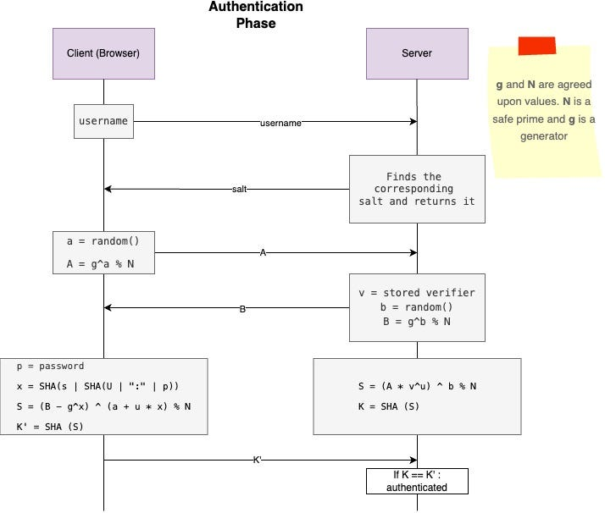
Concepts and Methods
Department of Computer Science & Engineering, MITSoE, Loni Kalbhor

Slide 9


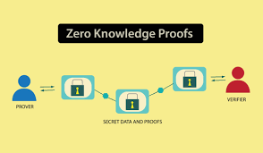
Implementation
We are going to implement ZKP in an environment to improve security and enhance out understanding about different algorithms and encryption techniques.
Department of Computer Science & Engineering, MITSoE, Loni Kalbhor

Slide 10




Our Team
Pradnya Khore
Yogesh Thakur
Gaurang Sharma
Kaushal Chordiya
Department of Computer Science & Engineering, MITSoE, Loni Kalbhor

